Slide 1

#LifeKoKaroLift
Lending Club Case Study:
Exploratory Data Analysis

Slide 2



Course : EDA
Analyzed By : Richard Samuel
Praveen Bhogoju

Slide 3

Lending Club – Problem Statement
As a lender,
I want to know who can I lend money based on the previous data I have
What type of customers are likely to pay off my loan?
Is there a common segment of people who borrows loan for specific purposes?

Slide 4
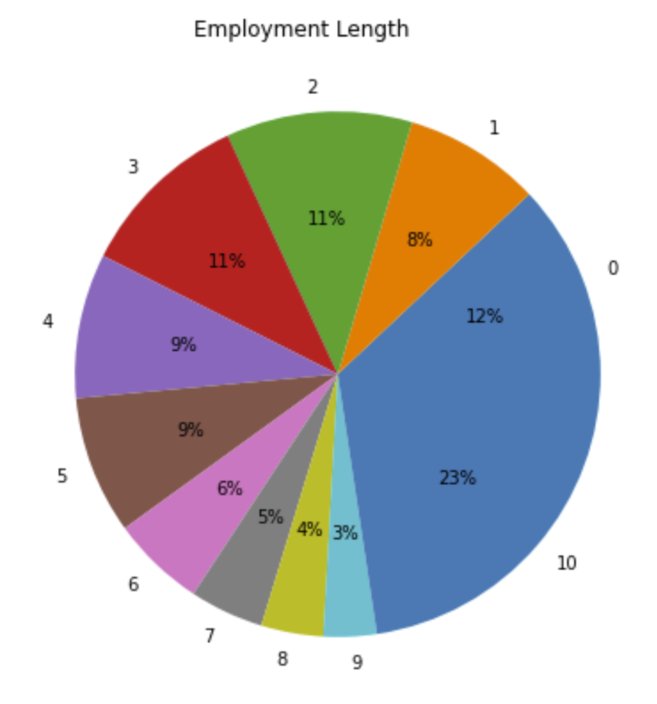
Lending Club: EDA
Who is borrowing more loans?
Customers with 10 plus years of experience borrow more loans.

Slide 5
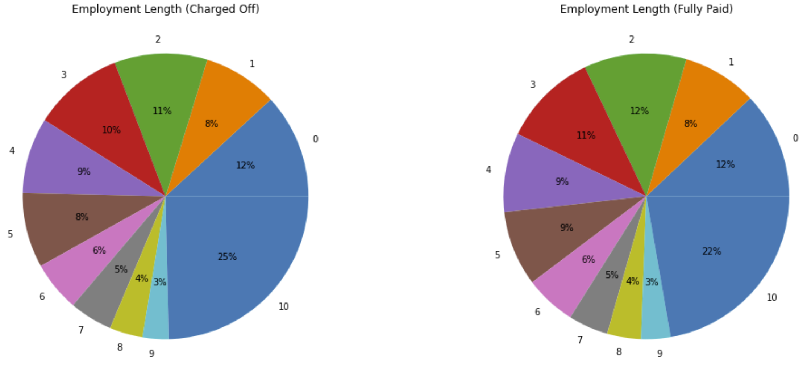
Lending Club: EDA
Who is not paying?
25% of the people in 10 years plus experience segment do not pay. There is a 3 percent increase of non-payers in this segment than fully paid customers whereas other segment payers and non-payers are about the same.

Slide 6
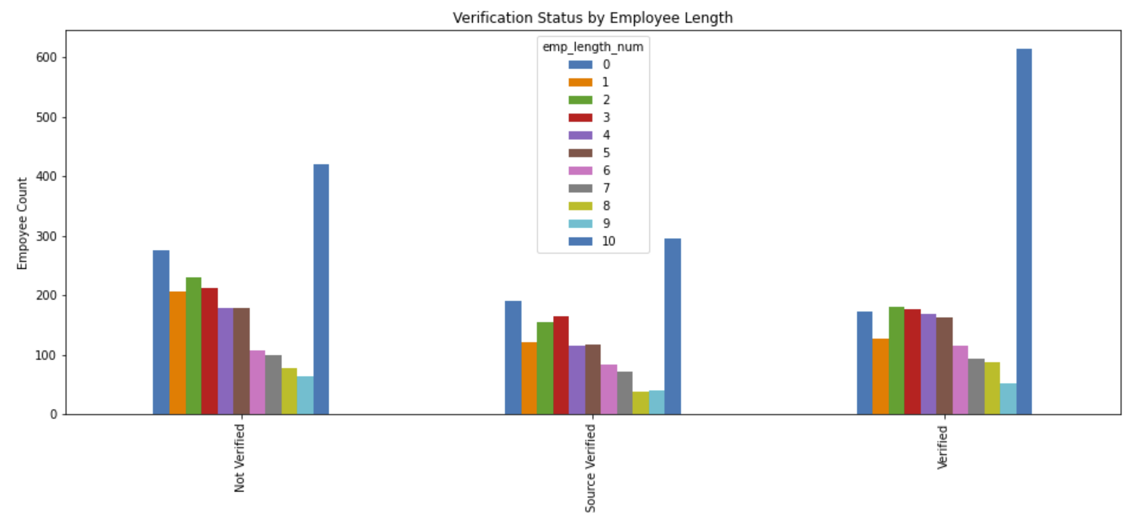
Lending Club: EDA
Who is more unlikely to charge off?
In the customers charged off chart above, applications with source verified by third party in any employment length segment are more unlikely to charge off.
While the customers with 10 plus years on employment tend to charge off higher in any segment

Slide 7
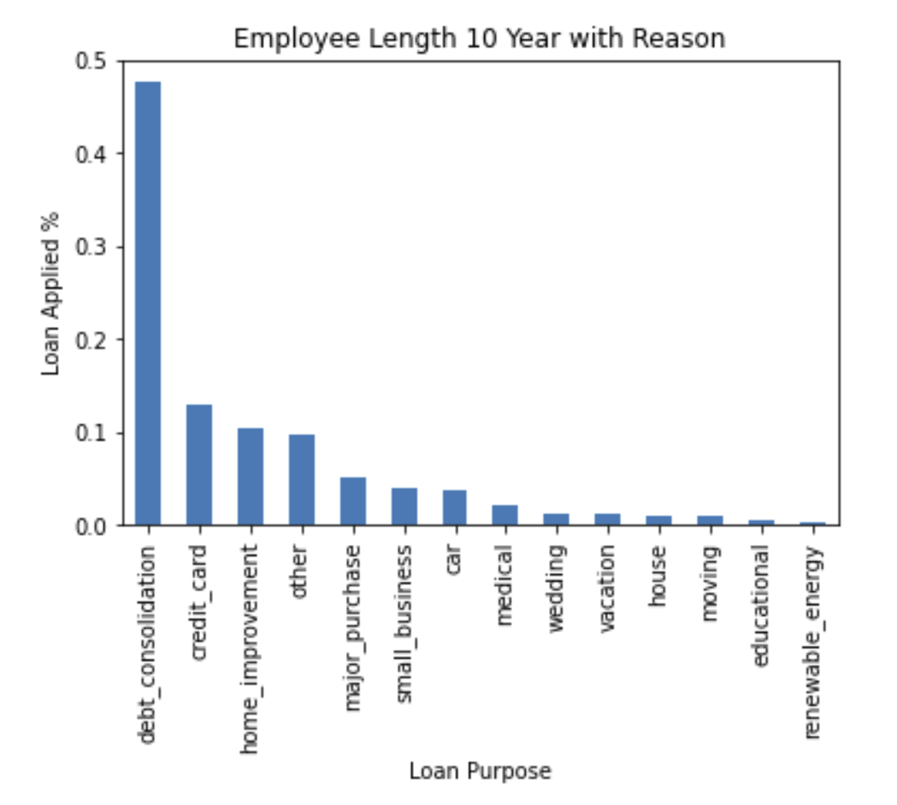

Lending Club: EDA
What is the purpose of loan?
In the 10 plus years employment segment, most of the loans are taken for the purpose of debt consolidation than all other purposes put together.
This sounds like a money juggle!

Slide 8
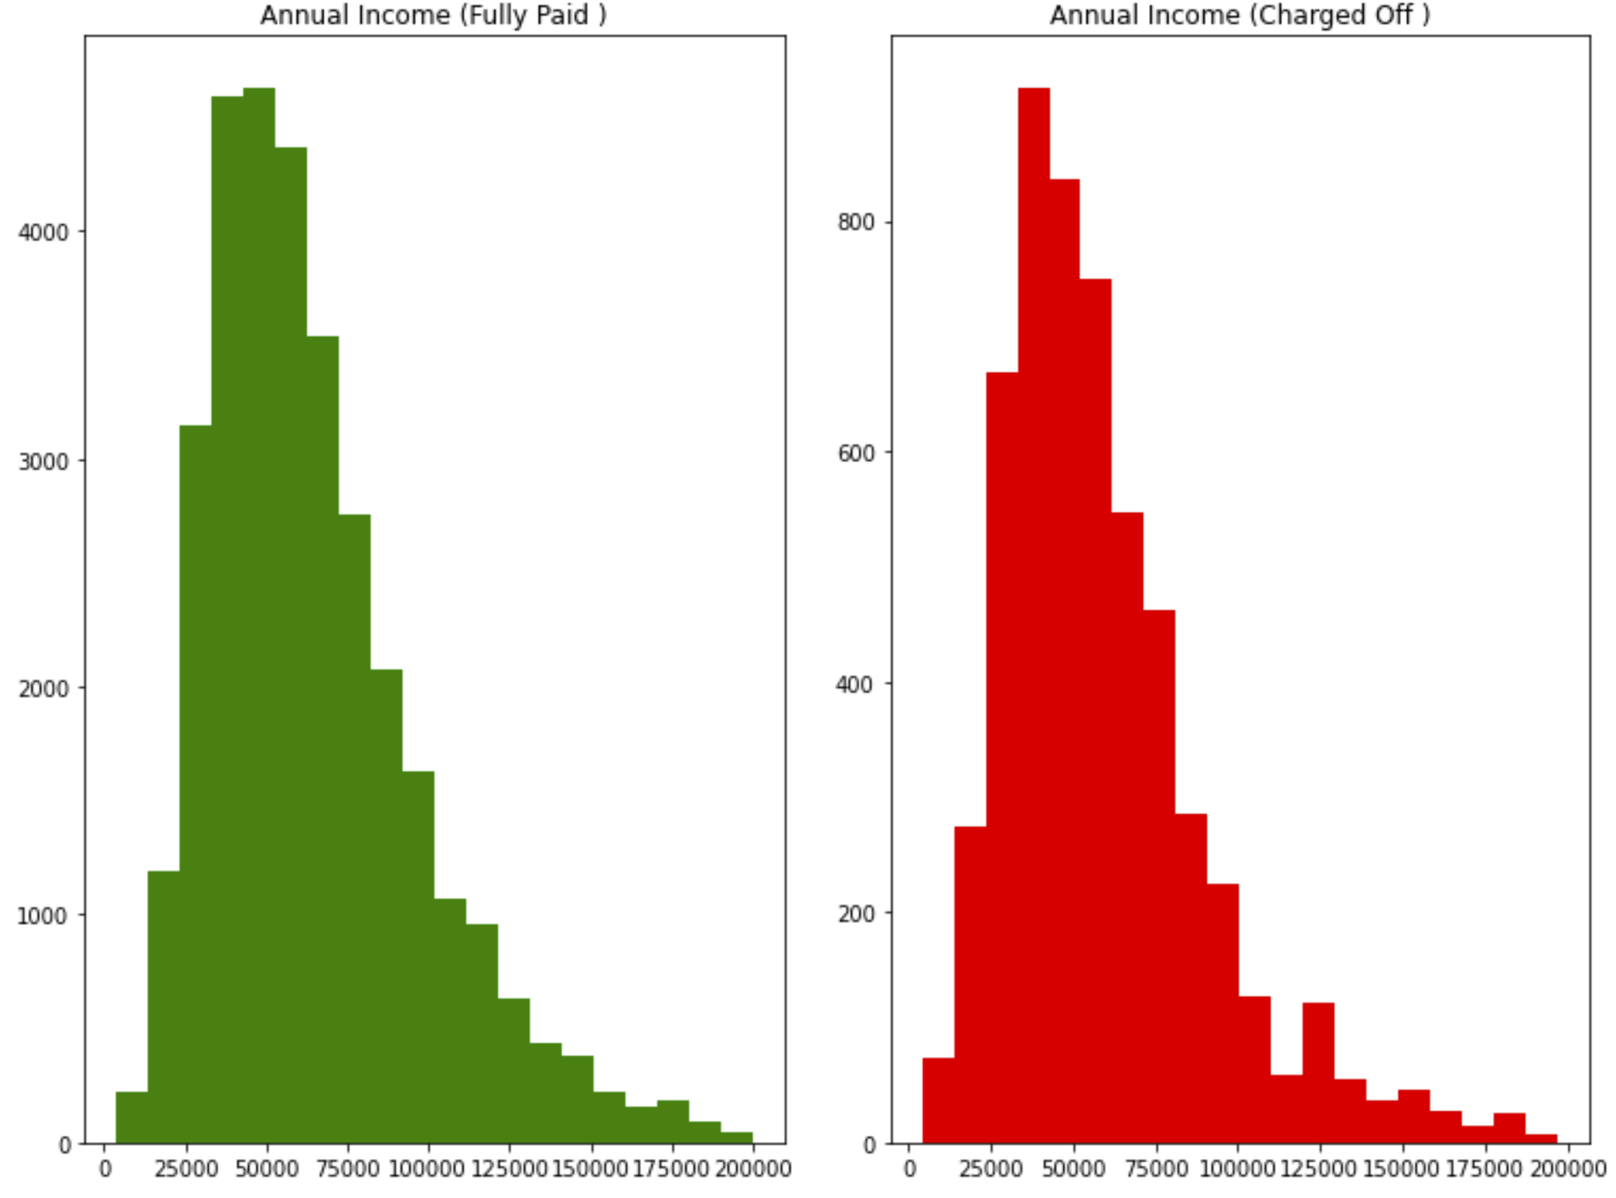
Lending Club: EDA
Annual income analysis
Customers with annual income between 25k and 120k pay off loans
There are fewer customers with annual income greater than 120k but charged off customers are higher as compared to other income groups.

Slide 9
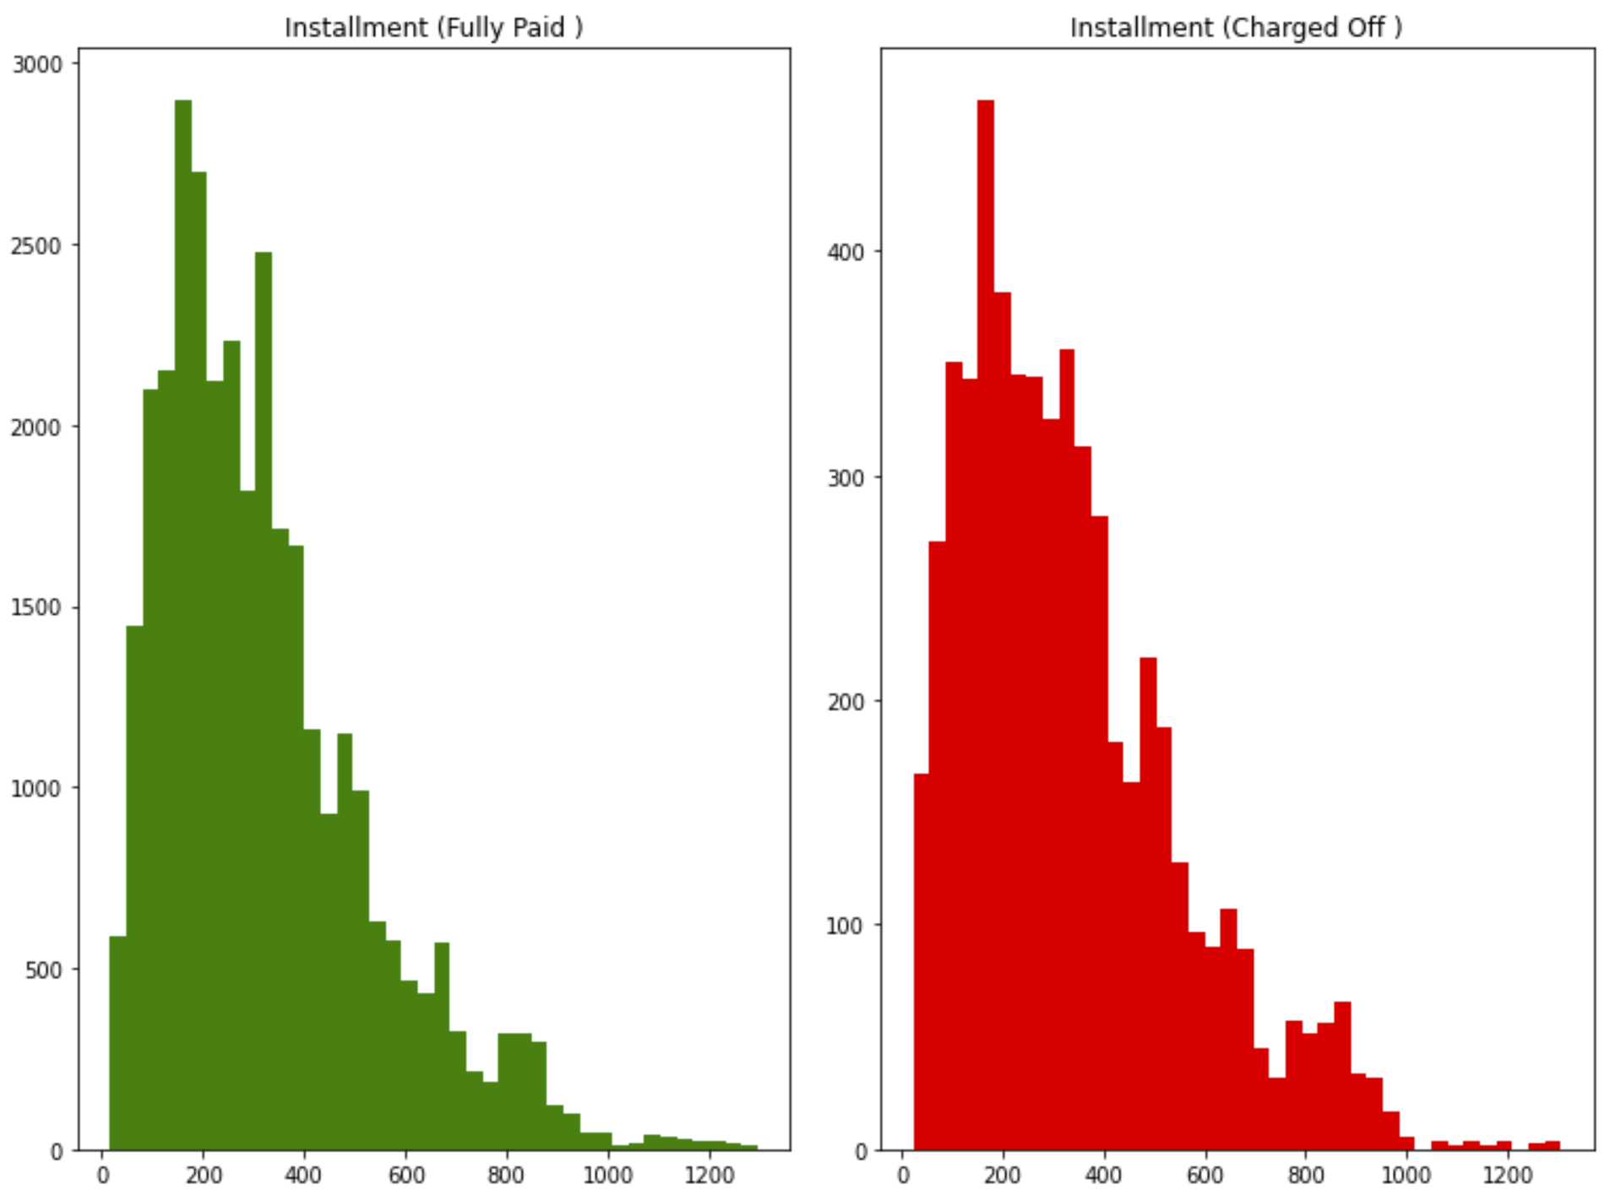
Lending Club: EDA
Installment Analysis
People with greater income are generally assumed to pay greater installment, however customers with installment amount greater than 500 charge off more than lower installments. This might be a reason for debt consolidation too.

Slide 10
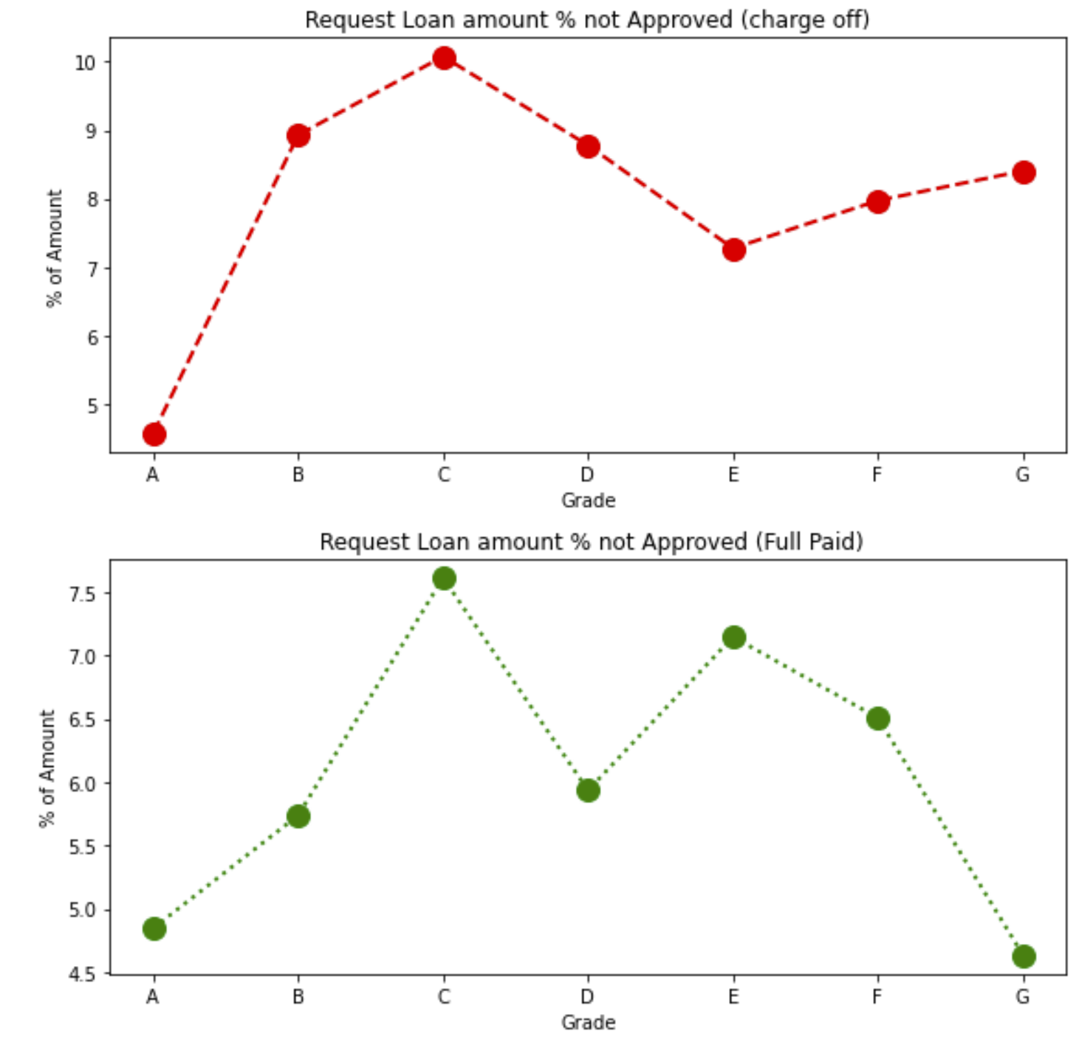
Lending Club: EDA
Who is paying off?
Grades B, D, F and G people whose funded amount invested is not lesser than 5% of the amount recommended by lending club analysts pay off the loan.
Mean of the percent invested in each grade is considered for this analysis.

Slide 11
Lending Club: EDA
Recommendations
Verification of income source through third party for:
Customers in the 10 plus years employment and who applies loan for debt consolidation.
Higher income customers earning more than 120,000 annual income
Installments greater than 600 per month
Approve no lesser than 5% of the recommended lending amount for customers in the grades B,D,F and G

Slide 12
#LifeKoKaroLift
Thank You!

